Slide 1
Instruments for climate action in natural heritage
30 September 2022

Slide 2
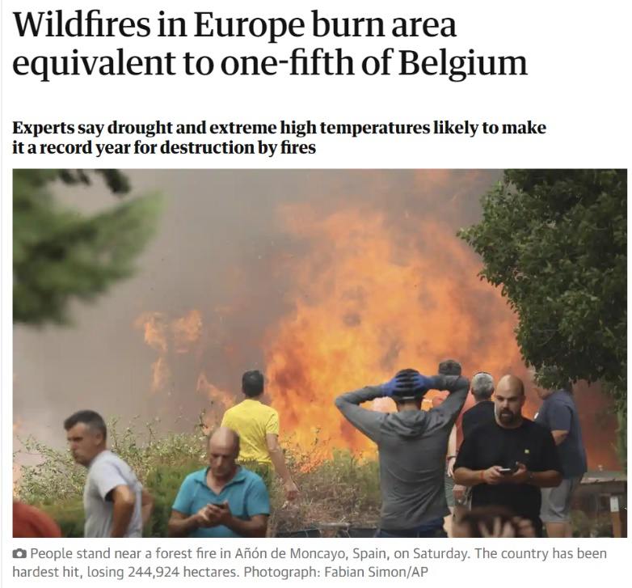
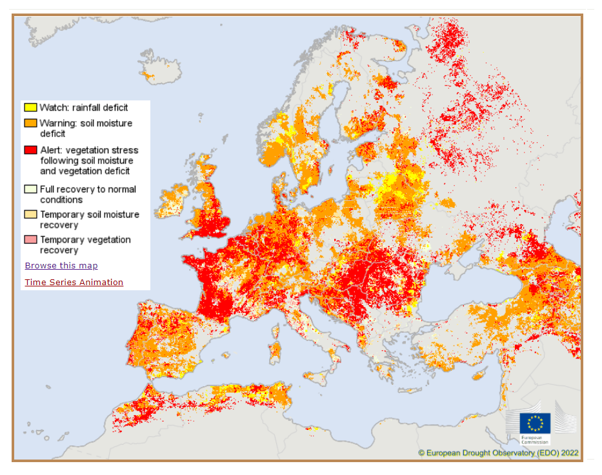
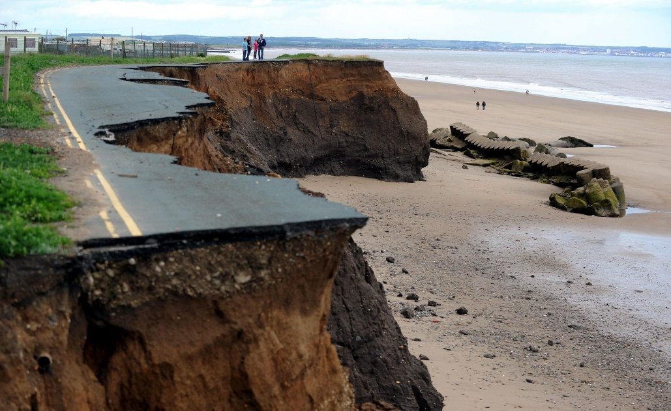
Climate change
Impacts are already here…
…affecting every region in Europe…
… and even in a best case scenario, impacts will be with us for decades.

Slide 3
Climate change impacts on biodiversity
Distribution and abundance of species and their interactions may change due to abiotic factors that determine plant growth conditions, vegetation structure and composition;
Populations of species may become increasingly isolated and vulnerable to local extinction;
Invasive species and new diseases may further erode the native biodiversity;
Direct impact on coastal and sea flora and fauna due to increasing water and air temperatures, sea level rise, and changes in wind pattern and storm likelihood;
Altered nutrient loads delivered to the sea due to changing precipitation and runoff patterns in river basins and increasing temperatures and changing agricultural uses;
Eutrophication and coastal and marine water quality affected.

Slide 4
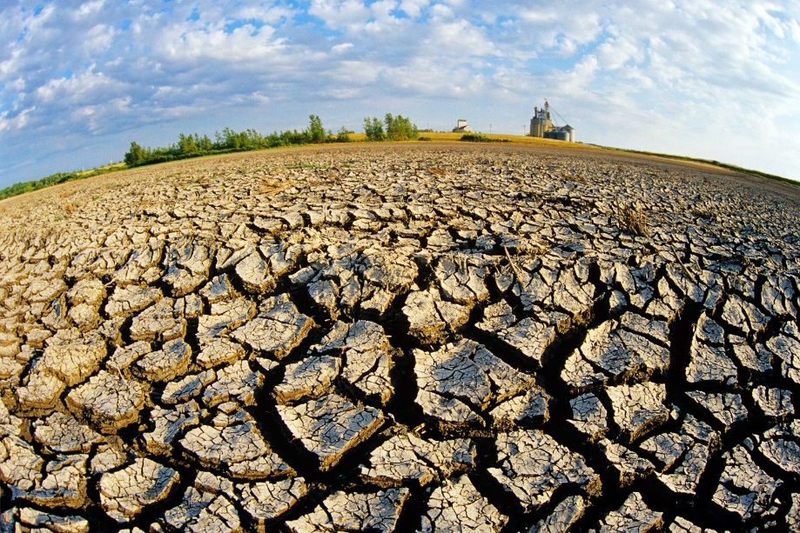
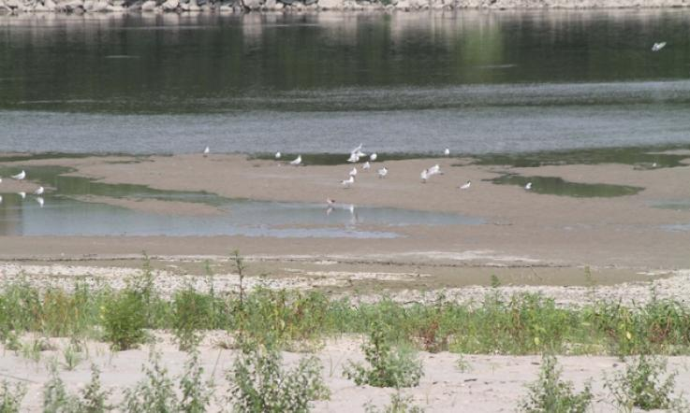
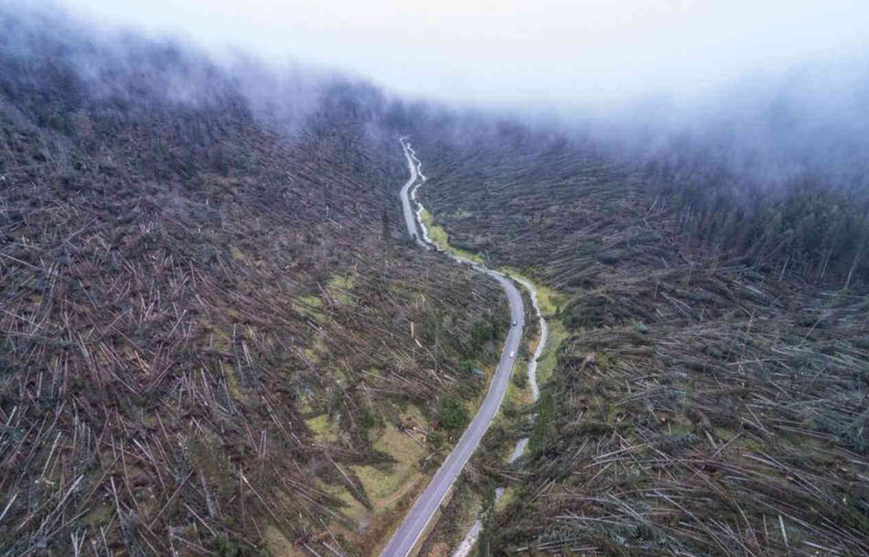
Climate change impacts on biodiversity
Some examples:
Progressive desertification of land
Saline water intrusion in the deltas of rivers
Sudden destruction of forests

Slide 5
EU Adaptation Strategy
Vision: climate resilience by 2050 and adapt to the unavoidable impacts of climate change
Objectives:
  Smarter adaptation – improving knowledge and managing uncertainty
  Swifter adaptation – speeding up adaptation across the board
  More systemic adaptation – support policy development at all levels and sectors, while promoting nature-based solutions for adaptation
  Stepping up international action for climate resilience
Notes:
The biodiversity loss and climate crises are interrelated and require coordinated action
EU policy acknowledges the critical role that green and blue landscape elements
The prospective changes from a static conservation perspective to an adaptative management approach, which involves the consideration of potential climate impacts and the design of management actions that take those impacts into account.
Conserving and restoring ecosystems, for example by restoring peatlands and natural hydrological conditions in river basins, is not only beneficial for biodiversity itself, but is also instrumental to reduce impacts of climate change on society
Nature-based Solutions are seen as a key mechanism for tackling the dual crisis of biodiversity loss and climate change, as well as for the potential in providing benefits to nature, society and the economy.

Slide 6
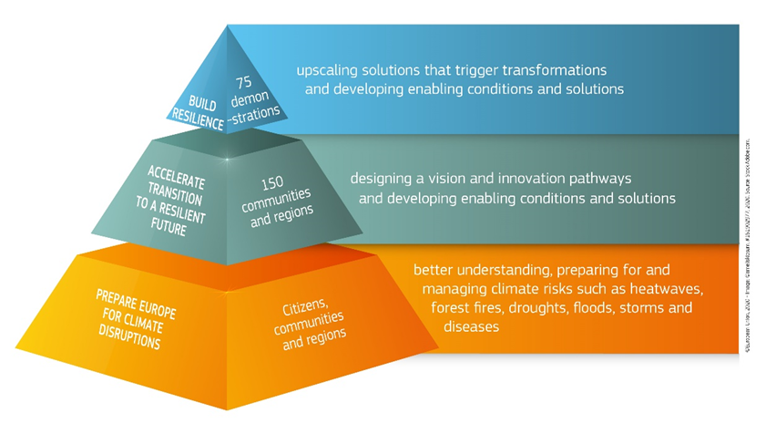
A new EU instrument:
Mission Adaptation to Climate Change
Objective: support at least 150 European regions and communities towards climate resilience by 2030
Help European regions:
better understand climate risks
develop pathways and prepare
test and deploy solutions
Notes:
The development of accurate local models and their projection under climate scenarios is important for defining local adaptation strategies to climate change and variability.
Even if climate change projections were available, climate change modelling is not able to predict the exact sequence of many phenomena, such as wave and storm surge events in the future.
Increasing preparedness by building resilience is key

Slide 7
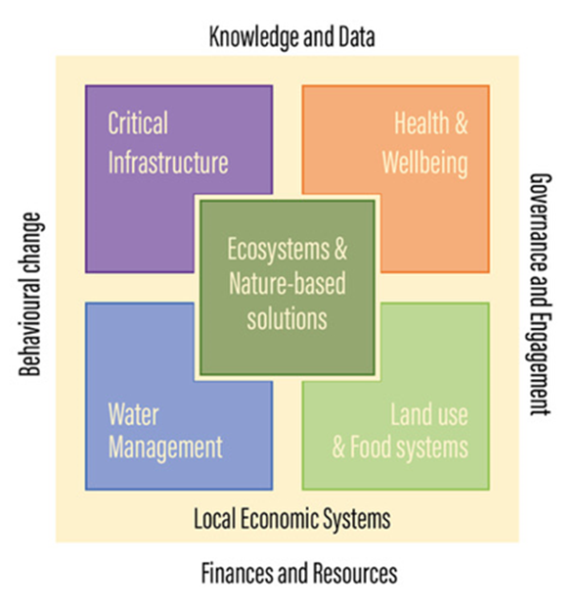
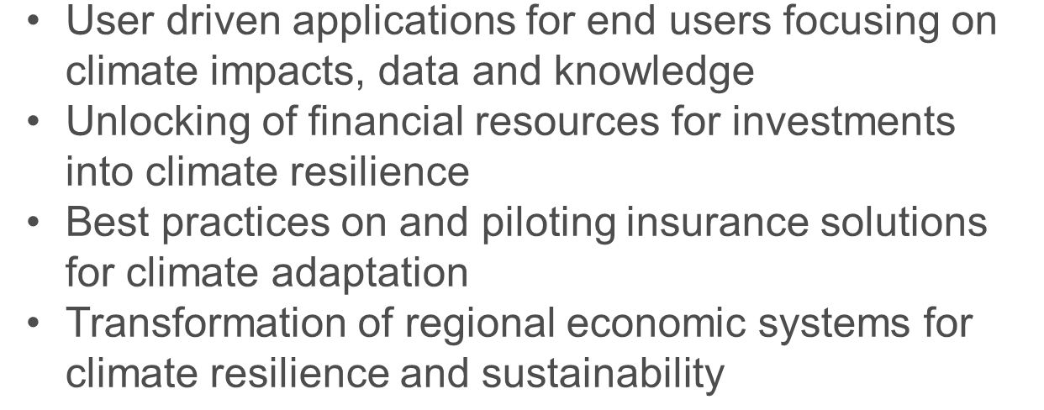
Approach:
Demonstrating innovative solutions to transform the key systems into more climate resilient:
    putting ecosystems and nature-based solutions at the centre;
    at scale and in real life,
    in line with the national / regional adaptation plans,
    ensuring citizens and stakeholder engagement,
    Assuring sustainable solutions after the end of the project.
Collecting best available knowledge and experimenting on enabling conditions, e.g.:

Slide 8
Mission Charter
Why the Mission Charter?
be part of a community of practice on adaptation to climate change
network and share with other regions and local authorities
join the annual Mission Forum to share experience, take stock of the collective progress and contribute to steer the Mission actions

Slide 9
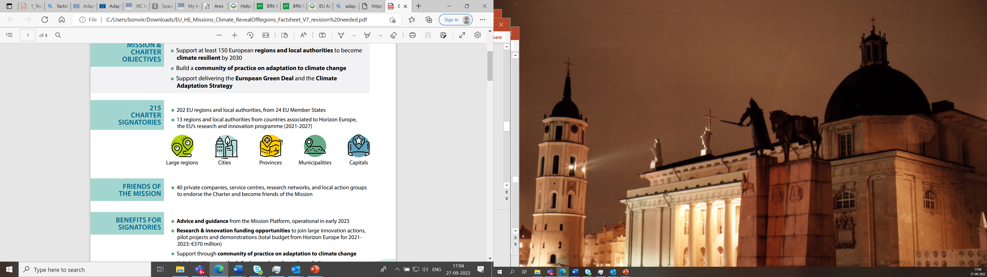
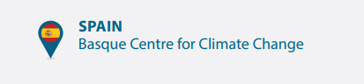
Mission Charter Signatories

Slide 10
How the Mission support the Regions?
MIP
Horizon Europe
Calls
PCP and PPI
EIB
and other Programmes
Climate-ADAPT
JRC
Horizon Europe project grants: calls currently opened and future yearly calls (eg possible support to public procurers to buy innovative/pre-commercial solutions for climate resilience)
Services by Mission Implementation Platform (MIP)
Scientific guidance and support by the Joint Research Center (JRC)
Access to climate adaptation knowledge from Climate-ADAPT by EEA
Facilitate access to EIB Climate Adaptation Investment Advisory Platform (ADAPT)

Slide 11
Support through the Mission Implementation Platform
Capacity building and development
Knowledge on risk assessment methods
Citizens engagement
Access tools that the region can use to engage with citizens
Monitoring
and
evaluation
Communication
and
dissemination
Support to carry out climate risk assessments
Support to accelerate the roll-out of innovative solutions
Direct organization of events that empower citizens to act for adapting to climate change (together with the ClimatePact)
Network with other regions
Sharing experiences
Access adaptation best practices
from previous projects
Tracking progress and reporting on the Mission different streams of activities
Visibility for regional efforts and progress to tackle climate change

Slide 12
Horizon Europe Work Programme ‘21:
Budget 136 millions EUR
Calls closed on 12/04/22 – grants under preparation :
A common climate risk assessment framework, with cascading support to 50 regions for its implementation
Support to develop local climate resilience building strategies and plans, with cascading support to 100 regions
Citizens Engagement
Risk modeling at the asset level
Two large scale demonstrations taking place in the 5 regions each

Slide 13
Horizon Europe Work Programme ‘22:
Budget 120 millions EUR
Calls closed on 27/09/22 – proposal evaluations will start soon :
Applications and tools for local authorities focusing on climate impact, data and knowledge
Unlocking financial resources for investments into climate resilience
Best practices on and piloting insurance solutions
Transformation of regional economic systems for climate resilience and sustainability
Boost the sponge function of landscape to improve water management
Testing and demonstrating transformative solutions , mainstreaming nature- based solutions
Demonstration for coastal resilience in the Artic and Atlantic sea basin

Slide 14
#EUmissions
#HorizonEU
#MissionClimate
Notes:
Find out more here:
https://myintracomm.ec.europa.eu/dg/RTD/eu-missions/Pages/default.aspx (internal)

